Slide 1
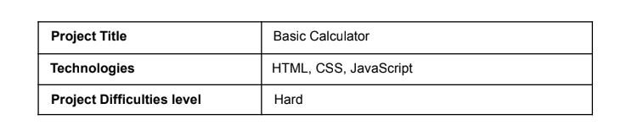
PROJECT 1(BASIC) -BASIC CALCULATOR
-SUBMITTED BY
PRINCE DEEPAK J K

Slide 2
Introduction :
In this project, we utilize HTML and CSS to build a basic, user-friendly calculator. Our aim is to showcase how these technologies can be used to create interactive web applications. The calculator features a simple interface, enabling users to easily perform basic arithmetic operations. By using HTML for content structure and CSS for styling and layout, we've developed a calculator that is both functional and visually attractive. This project demonstrates the effectiveness of HTML and CSS in creating web applications that are practical and appealing.

Slide 3
Objectives :
Design a user-friendly calculator interface.
Implement fundamental arithmetic functions.
Enhance front-end development skills.

Slide 4
Tools and Technologies Used
The project utilized the following technologies:
- HTML5 for content structure.
- CSS3 for styling and layout design.
- JavaScript for managing user input and executing arithmetic functions.
Development was done in a code editor, and the project was tested across various browsers to ensure compatibility.

Slide 5
Design and Implementation:
HTML:
- The HTML file includes a `div` element serving as the calculator's container.
- Within this container, there is an `input` element for the display and several `button` elements for the calculator keys.
CSS:
- The CSS file styles the calculator to resemble a traditional handheld device.
- It uses a grid layout for button arrangement, and defines font styles, colors, and ensures responsiveness for different screen sizes.
JavaScript:
- JavaScript captures button clicks to perform calculations.
- It updates the display with user input and the results of operations.
- It contains functions to manage the logic of each operation and evaluate the mathematical expressions entered by the user.

Slide 6
Project Features:
- A screen to display the current input and result.
- Buttons for digits (0-9), operations (+, -, *, /), and a decimal point.
- A clear button (C) to reset the current calculation.
- An equals button (=) to compute the result.

Slide 7
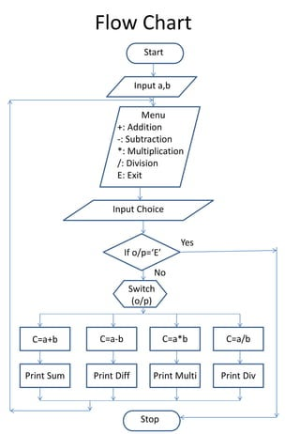
Flow diagram

Slide 8
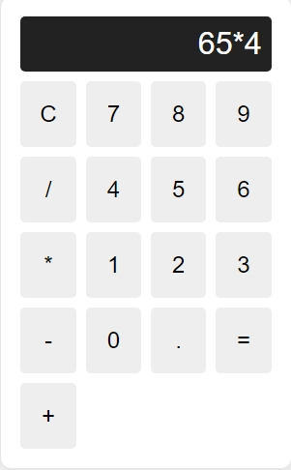
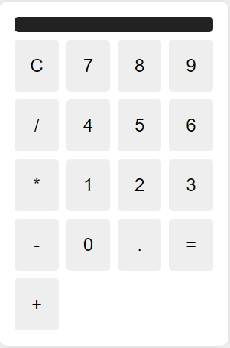
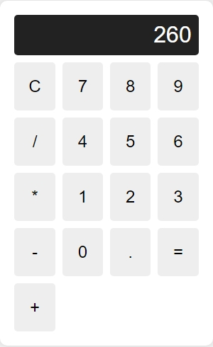
OUTPUT SCREEN:
PAGE 1:
PAGE 2:
PAGE 3:

Slide 9
Conclusion :
In this project, we built a simple calculator web application using HTML and CSS. The calculator showcases the essential features of these technologies in creating interactive web apps. It highlights the ability of HTML and CSS to design functional and visually appealing interfaces. This calculator provides a basis for adding advanced features, emphasizing the wide-ranging possibilities in web app development. Our project shows that even basic projects can demonstrate the power and flexibility of HTML and CSS, making them a great starting point for future web development projects.

